Slide 1
String
Rakib Mahmud

Slide 2
Introduction
The way a group of integers can be stored in an integer array, similarly a group of characters can be stored in a character array.
A string is a one-dimensional array of characters terminated by a null character( ‘\0’ ).

Slide 3
What is a NULL character (‘\0’)?
SLASH ZERO (‘\0’)
This character is the only way to find where the string ends.
An array that is not terminated by a ‘\0’ is not a string. It’s only a collection of characters (a character array)

Slide 4
String Variables
If a string variable needs to hold 5 characters, it must be declared to have length 6:
char str[5+1];
Adding 1 to the desired length allows room for the null character at the end of the string.
Failing to do so may cause unpredictable results when the program is executed.

Slide 5
String Initialization
char str[5];
It means str[0], str[1], str[2], str[3], str[4]
0, 1, 2, 3, 4 these are indexes
str[0] = ‘a’
str[1] = ‘b’
str[2] = ‘c’
str[3] = ‘d’
str[4] = ‘\0’
Initialization string during declaration:
char str[5] = {‘a’, ‘b’, ‘c’, ‘d’, ‘\0’}
char str[ ] = {‘a’, ‘b’, ‘c’, ‘d’, ‘\0’}
char str[ ] = “abcd”
char str[ ] = “abcd \
ef”
str[0] | str[1] | str[2] | str[3] | str[4]
‘a’ | ‘b’ | ‘c’ | ‘d’ | ‘\0’

Slide 6
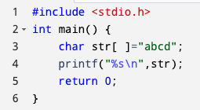
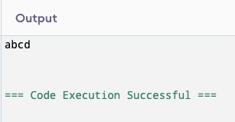
Printing a string
Declare and initialize a string.
Use the printf function to print the string.
%s is the format specifier for strings in C.
str is passed to printf to print the contents of the string.

Slide 7
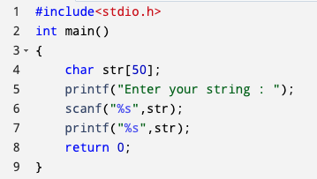
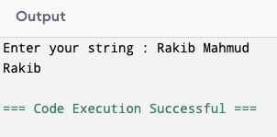
Read a String Input From the User and Display String
NB: Here, the string is read only till
the whitespace is encountered.

Slide 8
Key Note
You might be thinking that why ‘&’ sign is not used with the string name ‘str’ in scanf statement!
To understand this you will have to recall your knowledge of scanf.
The ‘&’ sign is used to provide the address of the variable to the scanf() function to store the value read in memory.
As str[ ] is a character array so using str without braces ‘[’ and ‘]’ will give the base address of this string. That’s why ‘&’ is not used in this case as we are already providing the base address of the string to scanf.

Slide 9
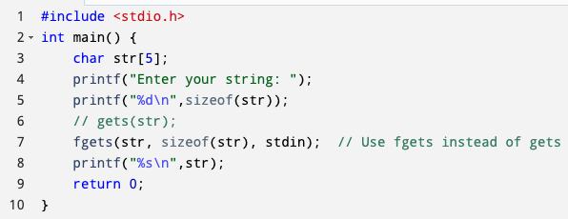
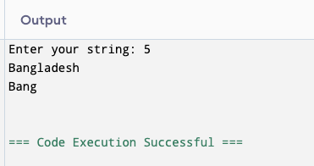
Read a String Input From the User and Display String (Cont’d)
NB: Use ‘fgets()’ instead of ‘gets()’.
‘gets()’ is not safe to use because it
does not check the array bound.

Slide 10
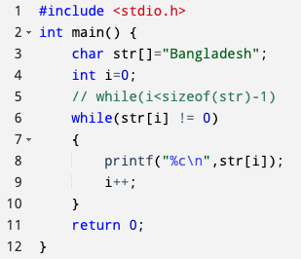
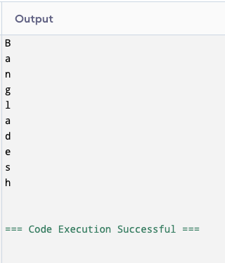
Display string character-wise

Slide 11
String.h Functions
Function Name | Description
strlen(string_name) | Returns the length of string name.
strcpy(destination, source) | Copies the contents of string source to string destination.
strcmp(s1, s2) | Compares the first string with the second string. If strings are the same it returns 0.
strcat(s1, s2) | Concat s1 string with s2 string and the result is stored in the first string.
strlwr( ) | Converts string to lowercase. (Only works in older versions)
strupr( ) | Converts string to uppercase. (Only works in older versions)

Slide 12
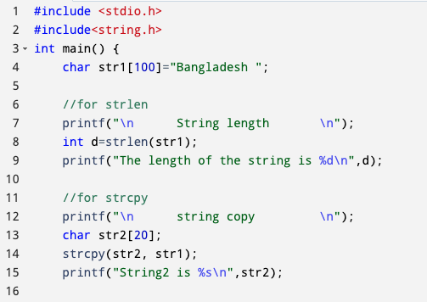
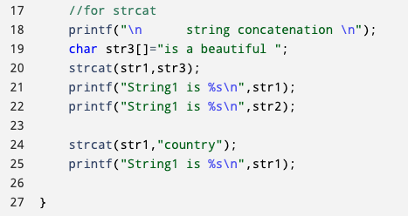
C Program for string.h Functions( strlen(), strcpy(), strcat() )

Slide 13
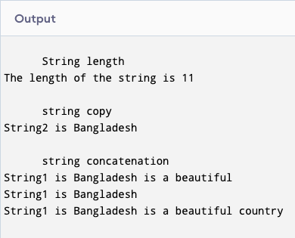
C Program for String.h Functions

Slide 14
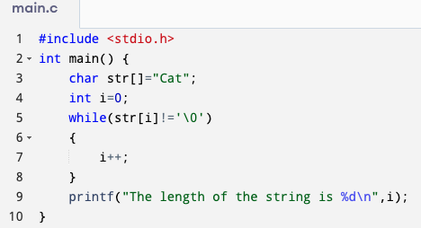
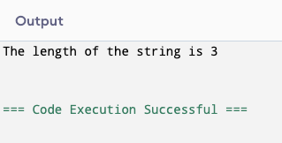
Finding The Length of The String Without The Help of strlen() functions

Slide 15
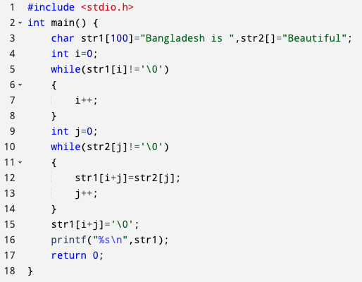
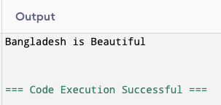
C Program for Concatenating Strings without strcat()

Slide 16
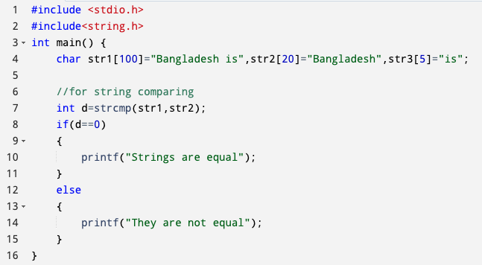
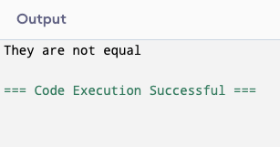
C Program for string.h Functions (strcmp())

Slide 17
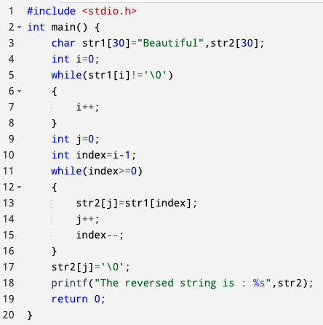
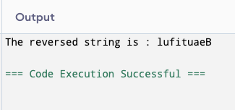
C Program to Do String Reversing

Slide 18
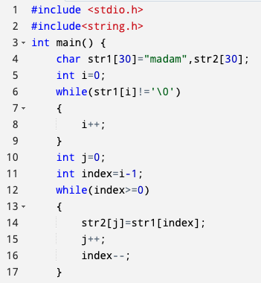
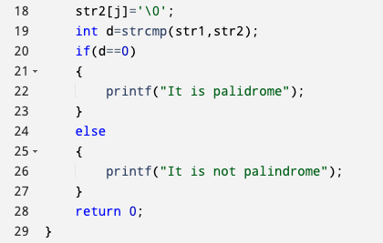

C Program for Checking A String Is Palindrome or Not

Slide 19
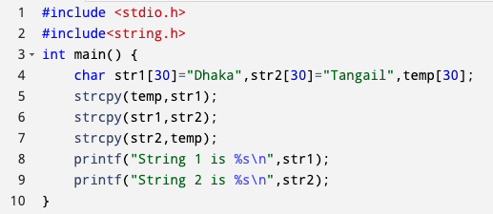
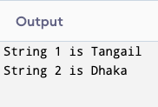
C Program to Do String Swapping

Slide 20
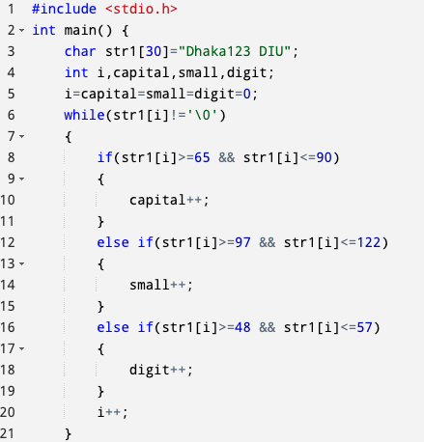

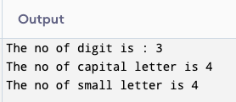
No of Capital, Small Letters and Digits in String

Slide 21
Thank You

